Slide 1
Response letter

Slide 2
But first: the decision letter
‘Sometime' after submission you will receive a decision letter

Slide 3
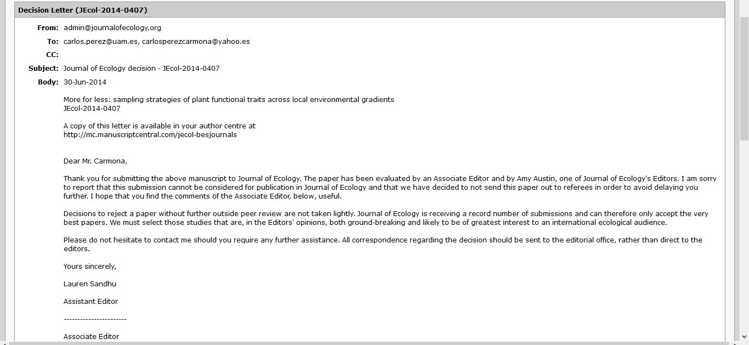
Reject without review ☹
→ Reformat ms and submit to a new journal

Slide 4
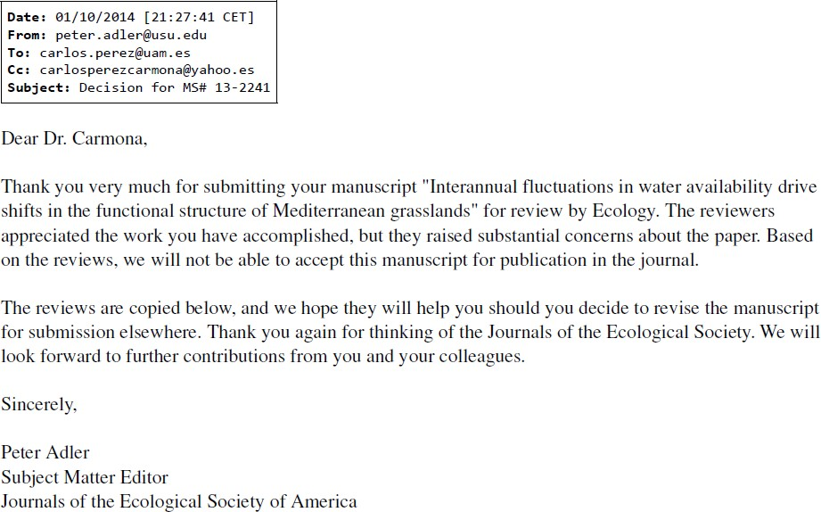
Reject after reviews ☹

Slide 5
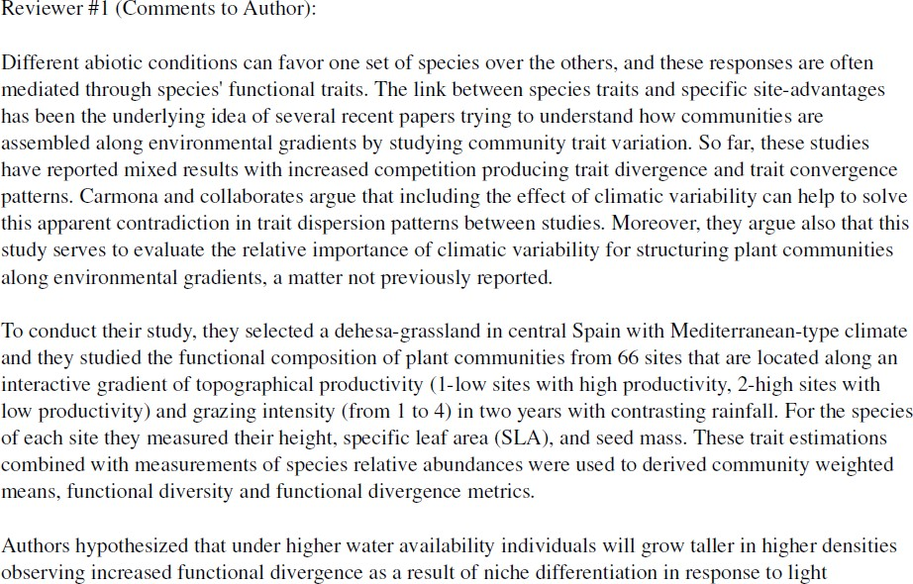
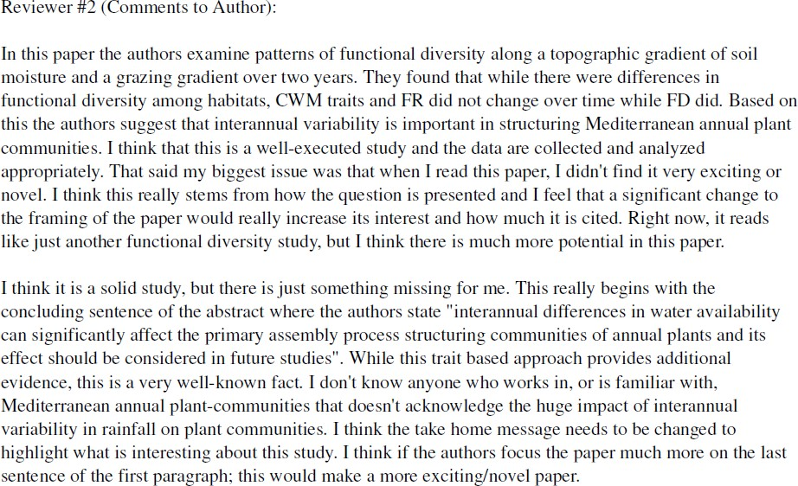
→ Incorporate changes that are reasonable, reformat, submit to another journal

Slide 6
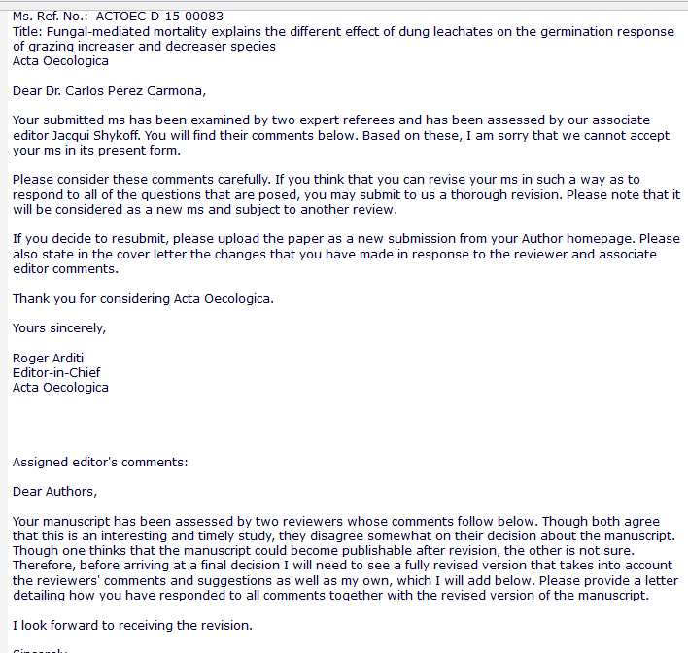
Reject and resubmission
→ Incorporate most changes
→ Resubmit as a “new” manuscript, but
including response to referees

Slide 7
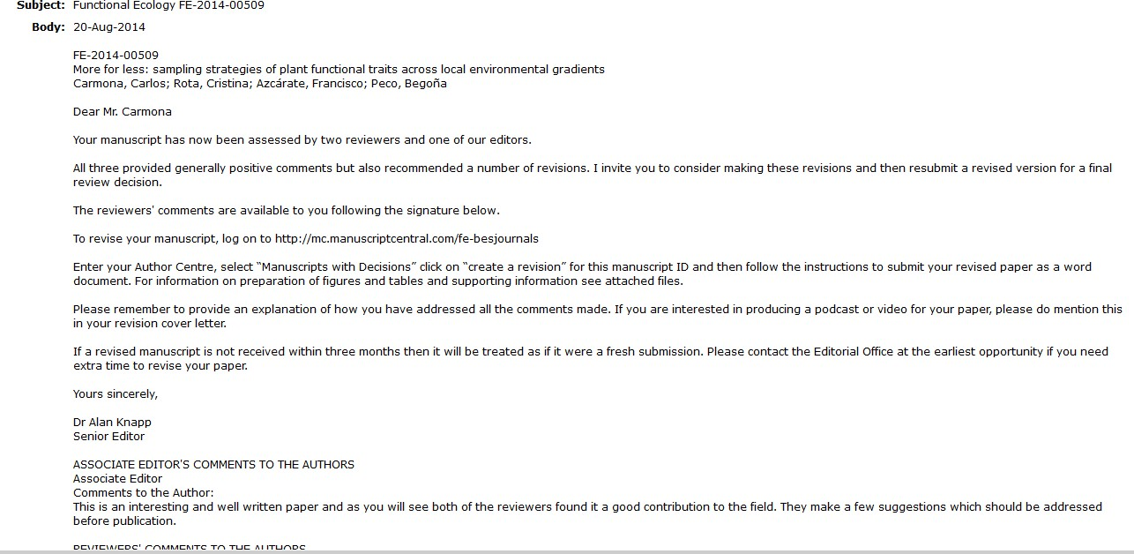
Major revision ☺ / minor revision ☺  ☺
→ Incorporate most changes
→ Resubmit including response to referees

Slide 8
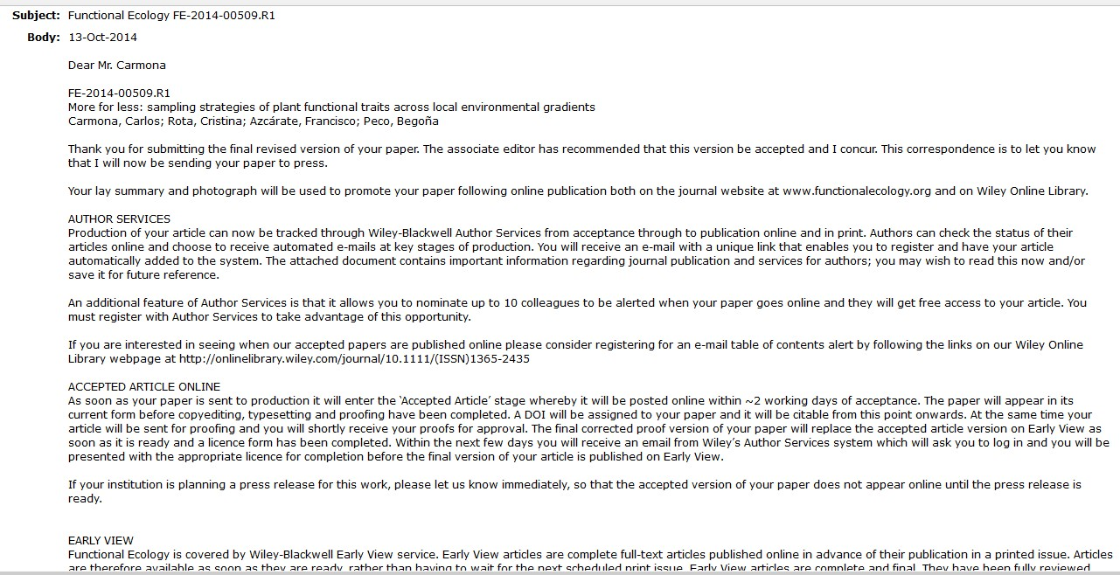
Acceptance
→ Celebrate!

Slide 9
Response letter
When you resubmit your paper after a revision, you have to:
  Make the changes in the main text
  Write a response letter, saying how you dealt with all the comments/concerns of the referees and editor.
  Reviewers expect you to accept the changes they propose. You MUST be careful! No second chances.

Slide 10
Response letter main aim: keep reviewers/editor happy!

Slide 11
Response letter: Content
Initial section acknowledging the work of the editor/reviewers
Recommendation: indicate the main changes in that initial section

Slide 12
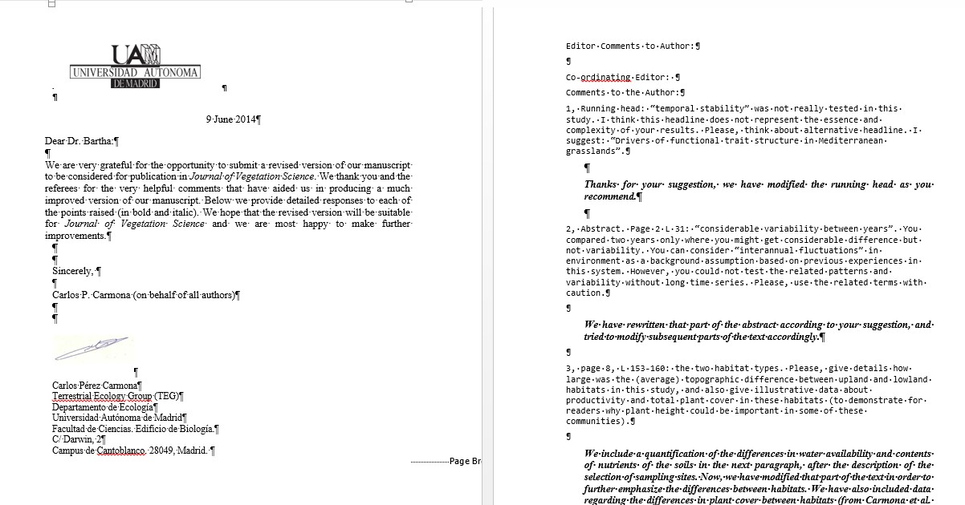
Sometimes the editor has detailed comments as well. Treat them as if they were comments from a reviewer.

Slide 13
Response letter: Content
A section for each reviewer
Keep the comments
Under each comment, indicate the changes you have made, or explain why you haven’t (in different font, color, …)
Optional: reproduce the new text
Alternative: indicate the line numbers in the ms where the changes have occurred, ideally in combination with color coding/track changing the changes in the revised ms (look out for journal‘

Slide 14
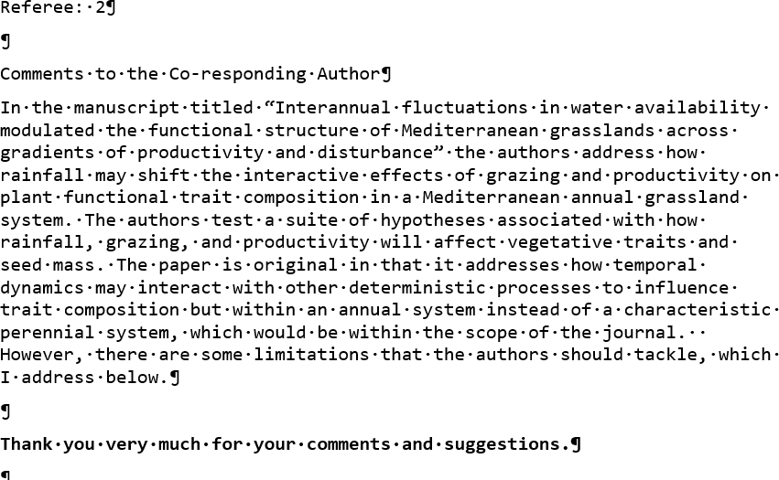
Most reviews will start with some general comments.
→ Start by saying thanks

Slide 15
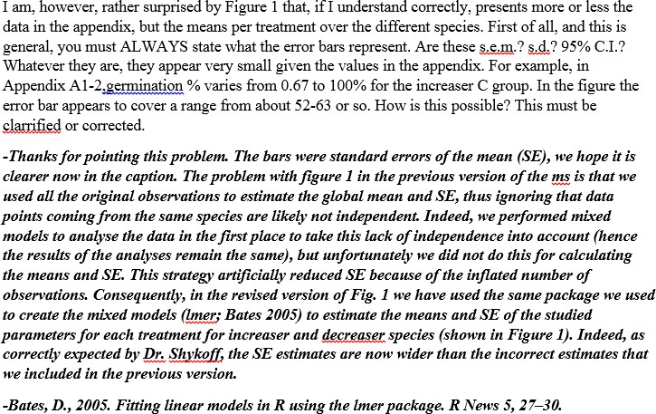
IF THE REFEREE IS RIGHT AND YOU CAN SOLVE THE PROBLEM:
→ Thank him/her for finding the problem
→ Try to address it in the best way you can, indicating in the letter what you did
Notes:
Do the same at the beginning of each of the major comments.

Slide 16
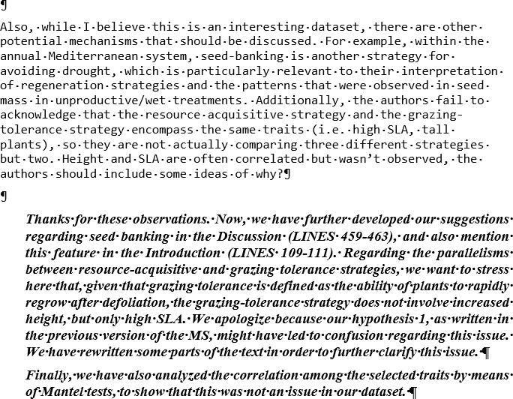
IF THE REFEREE DID NOT UNDERSTAND SOMETHING:
- Keep saying that the comments are interesting
- Try to address them in the best way you can, indicating where the changes are
- Try to assume (or at least say it in the letter) that if something was not well understood it is your fault

Slide 17
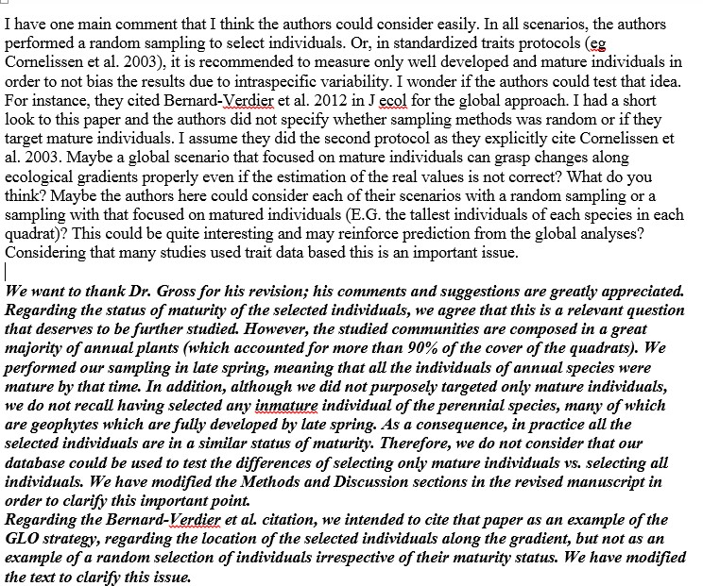
IF THE REFEREE PROPOSES SOMETHING YOU CANNOT DO:
- Keep saying that the comments are interesting!!! (the ‘it deserve
further/deeper/specific studies’ technique works well for me)
- Explain why you have not performed
the required changes
- Maybe even justify in the main text why you did not what the referee is asking for

Slide 18
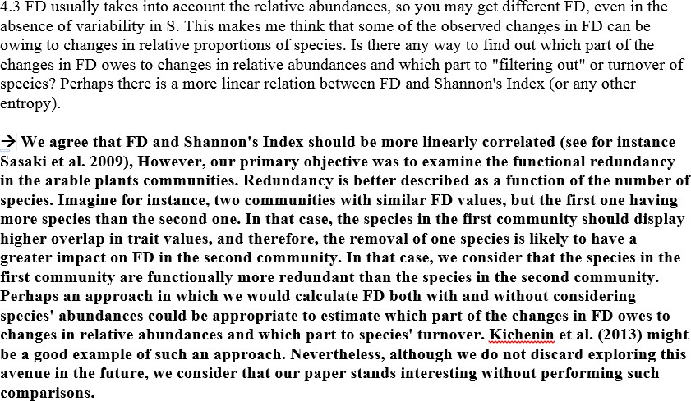
IF THE REFEREE PROPOSES SOMETHING YOU DON’T WANT TO DO:
Keep saying that the comments are interesting!!! (the ‘it deserves
further/deeper/specific studies’ technique)
Explain why you have not performed the required changes.

Slide 19
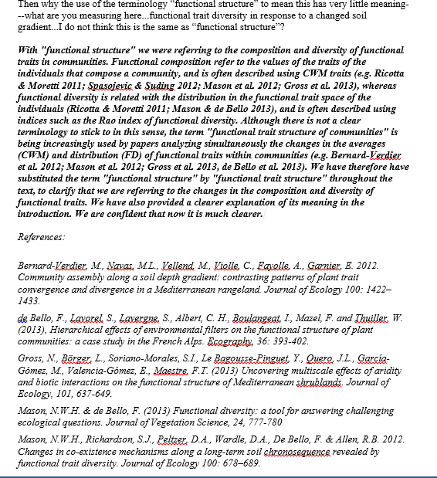
Try to support your arguments with citations of published studies doing whatever the problem is in the same way you did it.

Slide 20
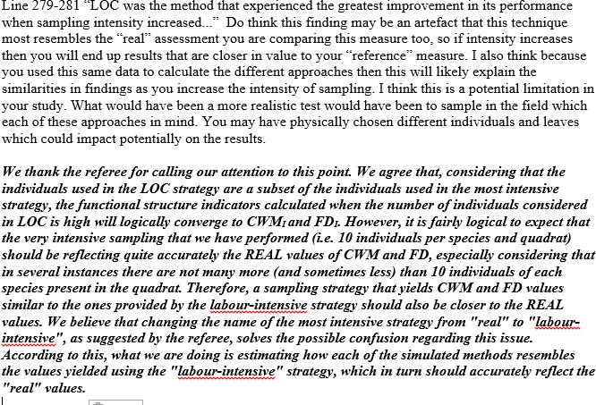
Sometimes changing some wording is a good way to get out of a problem.

Slide 21
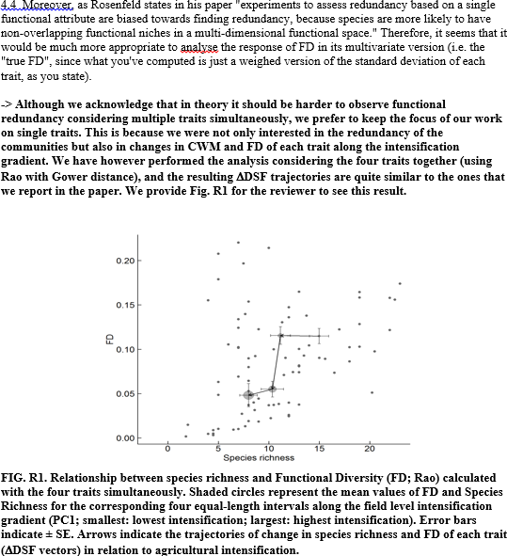
To support your arguments, you can include figures/new analyses in the response letter that you don‘t put in the ms!

Slide 22
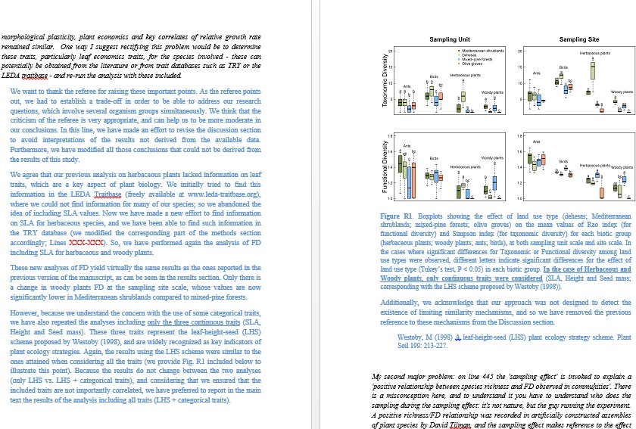
You can write extensive responses to justify why you did/didn’t do something!

Slide 23
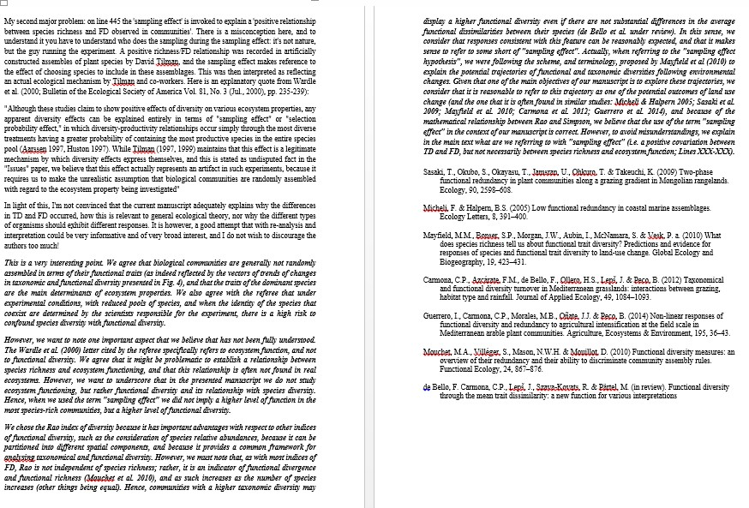
When you disagree with a suggestion, try to explain very well why, but always in a very polite and respectful way. Even if you think that the reviewer comes off as arrogant, don’t take it personal and stay as objective as possible.

